Slide 1
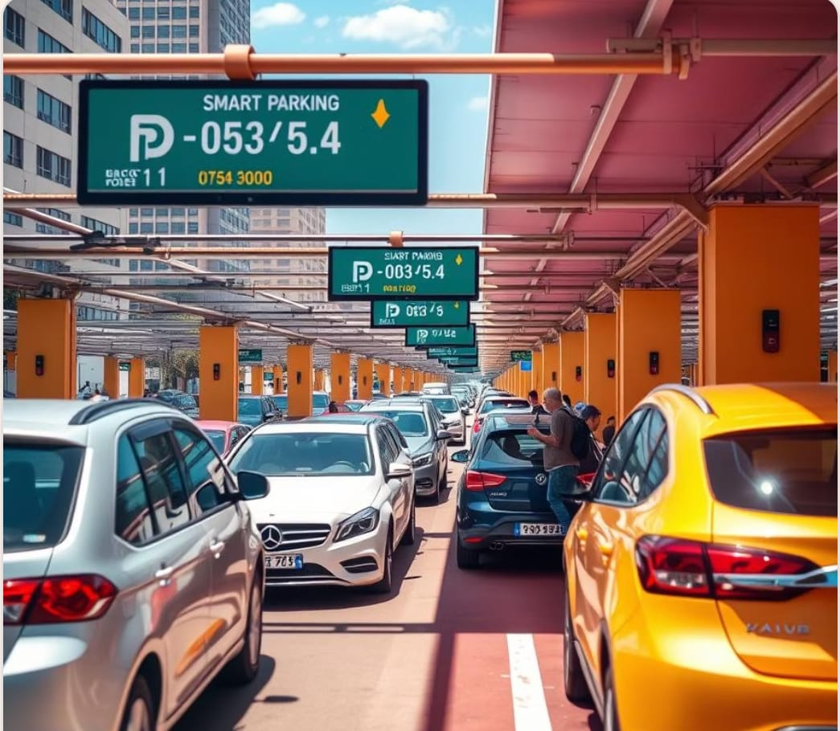
PARKING SLOT MANAGEMENT SYSTEM

Slide 2
TEAM MEMBERS
SK.ARSHAD AHAMED
SK.MD.RASIKH
S.LALITH
V.JAYASURYA

Slide 3
INTRODUCTION
The parking slot management system is a c program developed to manage parking spaces efficiently. It allows users to check available slots, park vehicles, remove them, and keep track of parking details. this system helps reduce manual work and improves the organization of parking areas using basic C programming concepts like linked lists, arrays, and structures

Slide 4
objective
Automate parking operations such as vehicle entry, exit, and slot allocation.
Track real-time availability of parking slots.
Ensure efficient utilization of limited parking space.
Record vehicle details (e.g., number, entry time) for tracking.
Calculate parking duration and fees accurately.
Minimize manual errors through automation.
Provide a simple console interface for ease of use.

Slide 5
DRAWBACKS
1. Lack of Built-in High-Level Features
2. Manual Memory Management
3. Poor Modularity and Maintainability
4. Limited Scalability
5. User Interface Limitations
6. Security Risks
7. Harder Integration with Hardware or Modern IoT Devices

Slide 6
System overview
1. Park a vehicle
2. Remove a vehicle
3. Display current parking status
4. Display parking history
5. Exit

Slide 7
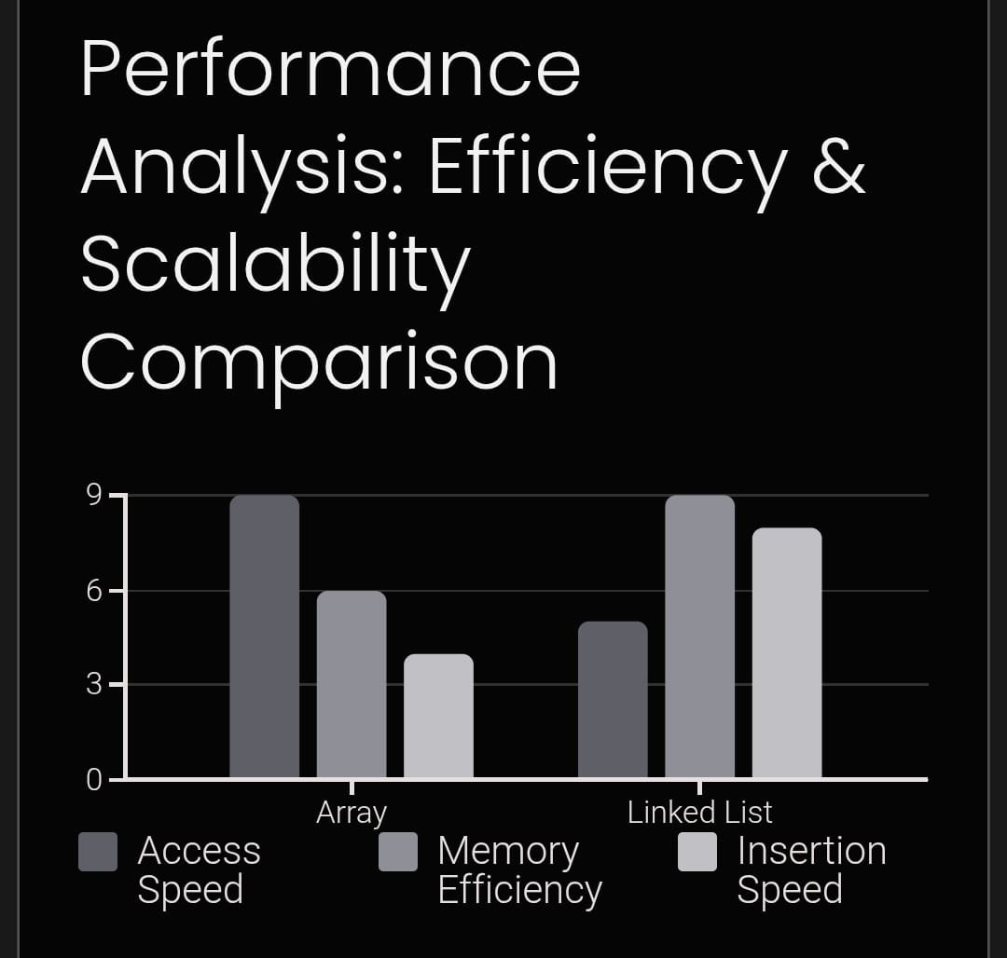
Technologies and tools
PROGRAMMING LANGUAGE : C LANGUAGE
TEXT EDITOR / IDE : DEV C++, NOTE PAD
DATA STRUCTURES : ARRAYS, LINKED LISTS
LIBRARIES USED :
Stdio.h
Stdlib.h
String.h
Time.h

Slide 8
advantages
1. Efficient Organization of Parking Data
2. Faster Search and Allocation
3. Dynamic Memory Management
4. Queue Management for Entry/Exit
5. simplicity and speed
6. time duration of vehicles

Slide 9
challenges
1. Manual Memory Management
2. No Built-in Data Structures
3. Pointer Complexity
4. Complicated Insert/Delete Operations
5. Lack of Modularity
6. Time Management and Scheduling

Slide 10
Source code
https://onlinegdb.com/XiU-ejUGd

Slide 11
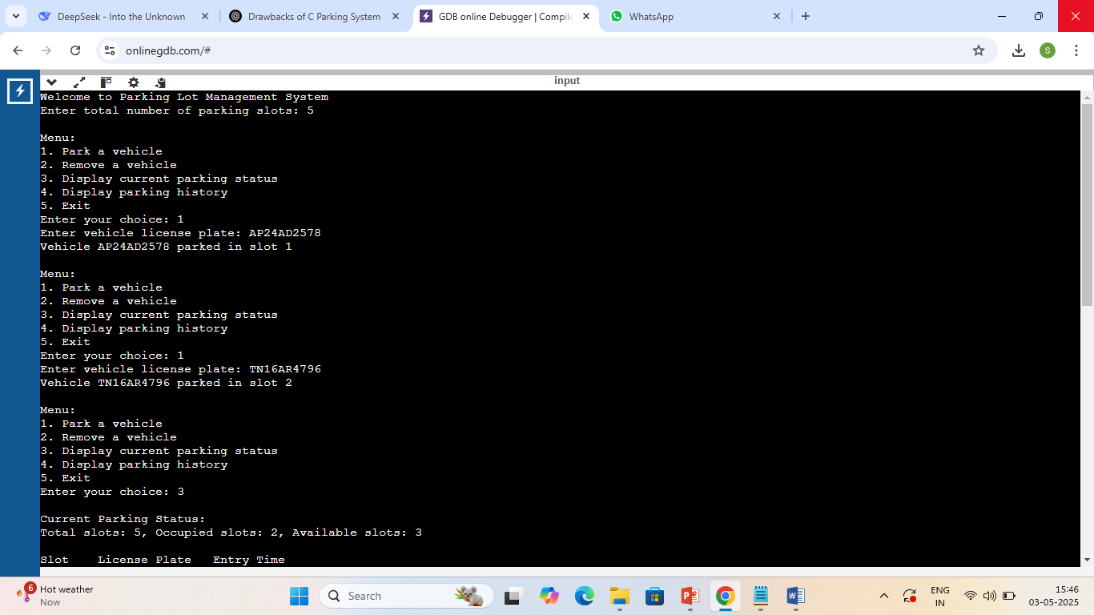
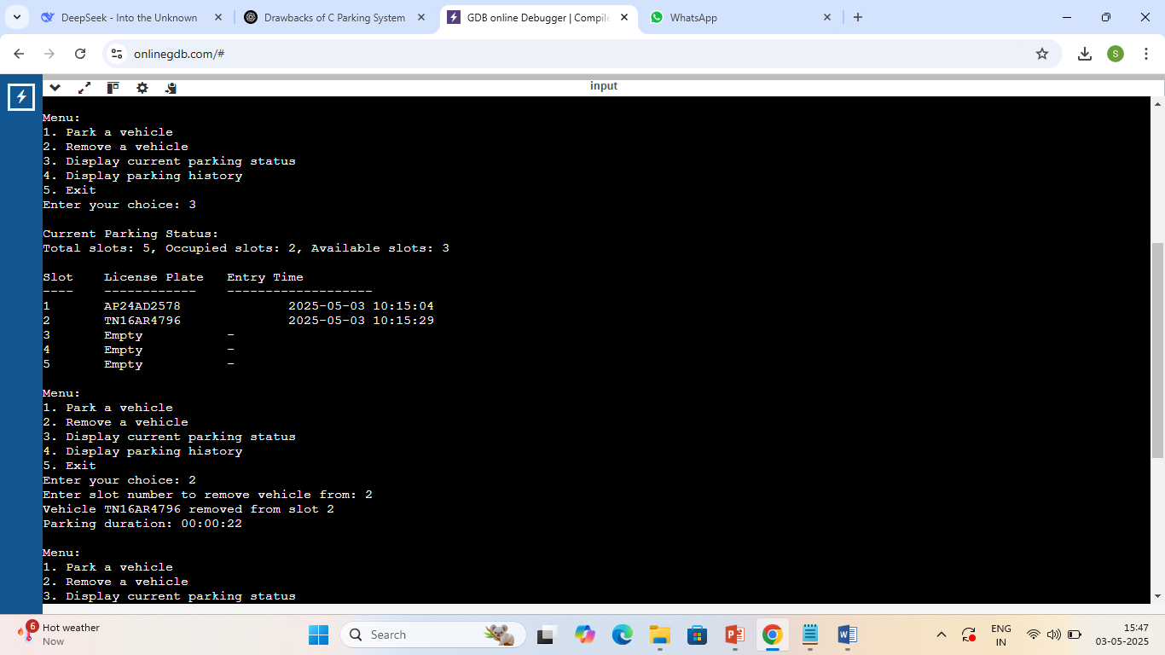
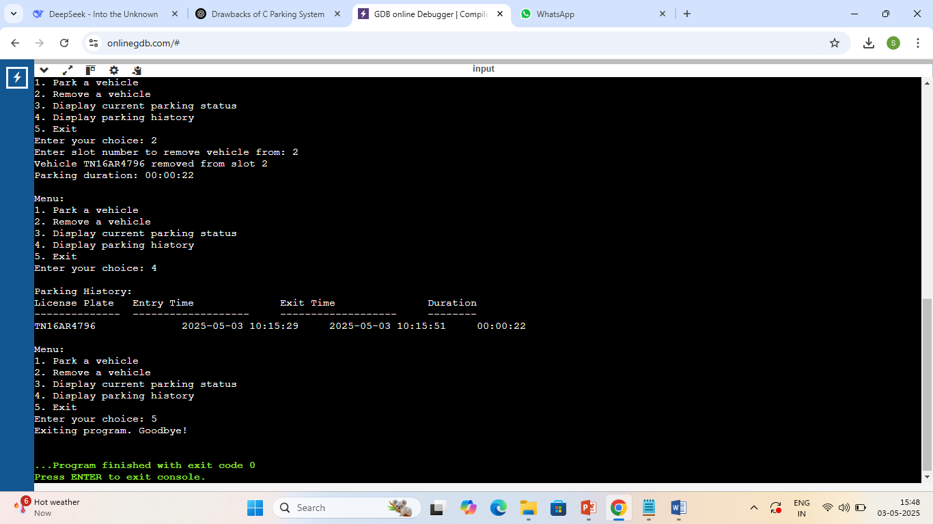
SAMPLE OUTPUT

Slide 12
conclusion
The Parking Slot Management System in C using data structures helps manage vehicles and parking slots in an organized way. By using data structures like arrays, linked lists, and queues, we can store and update parking information efficiently. This project shows how we can use C programming to solve real-life problems with simple logic and good planning. This system is fast and uses fewer resources, making it good for small or embedded systems. Overall, it’s a useful and educational project that combines programming and problem-solving.

Slide 13
THANK
YOU

